Slide 1
ICT 2103 Digital Logic Design
Prof. Dr. Muhammad Shahin Uddin
Email: shahin.uddin@mbstu.ac.bd

Slide 2
Textbook:
Digital Design
Morris Mano and Michae D. Ciletti, 2012, 5th Edition Pearson Education, ISBN-13: 978-0-13-277420-8
Reference Books:
1. Digital Design: Principles and Practices, J F Wakerly, 4thed, Prentice Hall, 2005
2. Digital Logic Techniques, T J Stonham, 3rded, Chapman & Hall, 1996

Slide 3
Lecture Outlines:
Course Contents:
This course provides an introduction to logic design and basic tools for the design of digital logic systems. A basic idea of number systems will be provided, followed by a discussion on combinational logic: logic gates, Boolean algebra, minimization techniques, arithmetic circuits (adders, subtractors), basic digital circuits (decoders, encoders, multiplexers, shift registers), programmable logic devices (PROM, PAL, PLA). The course will then cover sequential circuits: flip-flops, state transition tables and diagrams, state minimization, state machines, design of synchronous/asynchronous counters, RAM/ROM design. An introduction to programmable logic will also be provided. Hands-on experience will be provided through project on design of a sequential logic system. This course has separate mandatory laboratory session every week as CSE 231L.

Slide 4
Lecture Outlines:
Course Objective:
The objectives of this course are:
To introduce different number system and their application
To introduce Boolean logic operation and Boolean Algebra
To teach students how to use Boolean Algebra and K-maps to realize two-level minimal/optimal combinational circuits
To exposed students in the introductory design process of combinational and sequential circuits
To teach the operation of latches, flip-flops, counters and registers.
To explain how to analyze and design sequential circuits built with various flip-flops.
To understand the importance of state diagram representation of sequential circuits.
To analyze and design clocked sequential circuits.
To introduce using simulation tool for digital system design.

Slide 5
Digital Logic Design
Let me ask you few questions first…..(prerequisite knowledge?)
Did you take course on electrical circuits ??
Did you take course on electronics (Analog) ??
Do you know about signals (Analog/digital) ??

Slide 6
Digital Systems and Numbers
Digital Systems
Binary Numbers
Number-base Conversions
Octal and Hexadecimal Numbers
Complements
Signed Binary Numbers
Binary Codes

Slide 7
Digital Systems
Takes a set of discrete information inputs and discrete internal information (system state) and generates a set of discrete information outputs.
Discrete
Discrete
Inputs
Information
Discrete
Processing
Outputs
System
System State

Slide 8
Digital Systems
Application of Digital System
Communication
Business transactions
Traffic control
Spacecraft guidance
Medical treatment
Weather monitoring
Internet
Telephone switching exchanges
Digital camera
Electronic calculators, PDA's
Digital TV
Digital telephones
Digital televisions
Digital versatile discs
Digital cameras
Handheld devices, and
Digital computers
Many other commercial, industrial, and scientific enterprises.

Slide 9
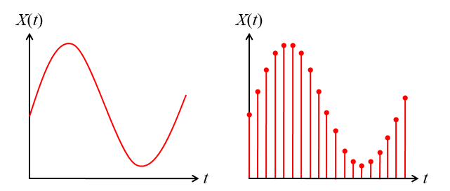
Analog and Digital Signal
Analog system
The physical quantities or signals may vary continuously over a specified range.
Digital system
The physical quantities or signals can assume only discrete values.
Greater accuracy

Slide 10
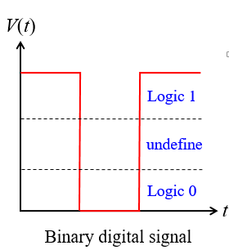
Binary Digital Signal
An information variable represented by physical quantity.
For digital systems, the variable takes on discrete values.
Two level, or binary values are the most prevalent values.
Binary values are represented abstractly by:
Digits 0 and 1
Words (symbols) False (F) and True (T)
Words (symbols) Low (L) and High (H)
And words on and off
Binary values are represented by values or
ranges of values of physical quantities.

Slide 11
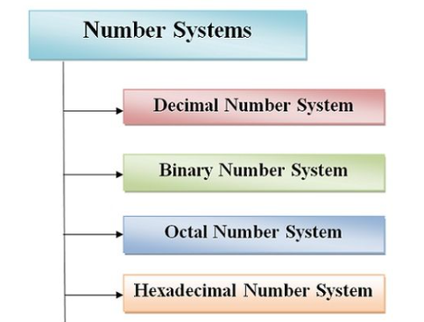
Number System
Non-Positioned Number System
Roman Number
I = 1, V = 5, X = 10, L = 50, C = 100, D = 500, M = 1000.
Positioned Number System
1999 is MCMXCIX, or M (1000) + CM (1000-100) + XC (100-10) + IX (10-1).

Slide 12
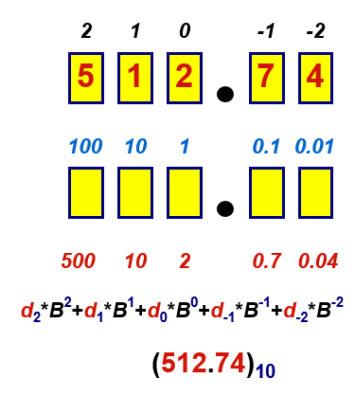
Decimal Number System
Base (also called radix) = 10
10 digits { 0, 1, 2, 3, 4, 5, 6, 7, 8, 9 }
Digit Position
Integer & fraction
Digit Weight
Weight = (Base) ^{Position}
Magnitude
Sum of “Digit x Weight”
Formal Notation

Slide 13
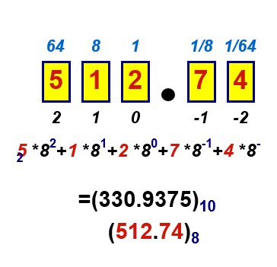
Octal Number System
Base = 8
8 digits { 0, 1, 2, 3, 4, 5, 6, 7 }
Weights
Weight = (Base) ^{Position}
Magnitude
Sum of “Digit x Weight”
Formal Notation

Slide 14
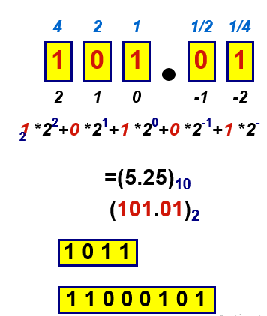
Binary Number System
Base = 2
2 digits { 0, 1 }, called binary digits or “bits”
Weights
Weight = (Base) ^{Position}
Magnitude
Sum of “Bit x Weight”
Formal Notation
Groups of bits
8 bits = Byte

Slide 15
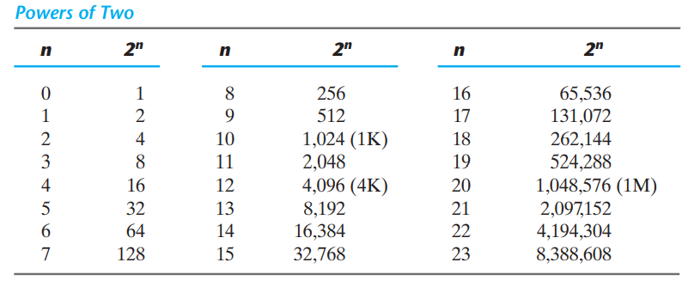
Binary Number

Slide 16
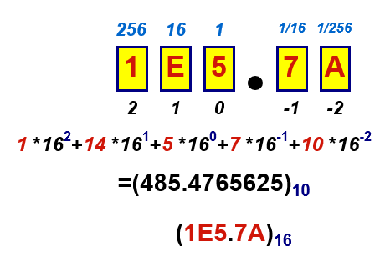
Hexadecimal Number System
Base = 16
16 digits { 0, 1, 2, 3, 4, 5, 6, 7, 8, 9, A, B, C, D, E, F }
Weights
Weight = (Base) ^{Position}
Magnitude
Sum of “Digit x Weight”
Formal Notation

Slide 17
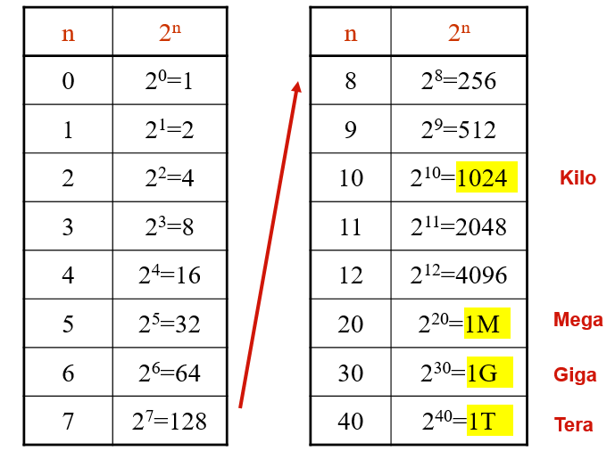
The Power of 2

Slide 18
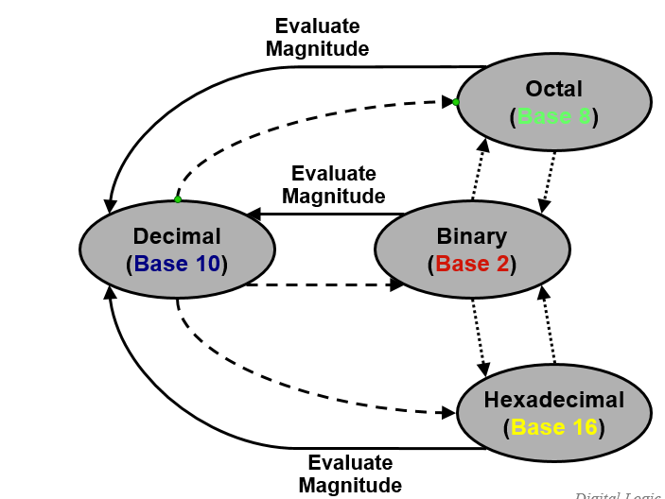
Number Base Conversions

Slide 19
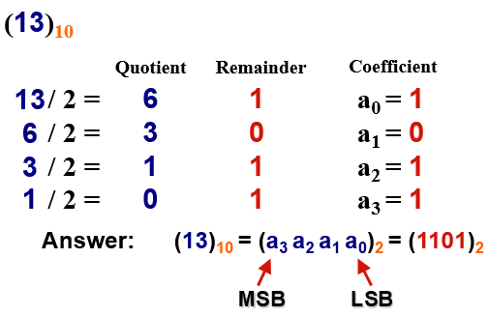
Decimal (Integer) to Binary Conversion
Divide the number by the ‘Base’ (=2)
Take the remainder (either 0 or 1) as a coefficient
Take the quotient and repeat the division
Example:

Slide 20
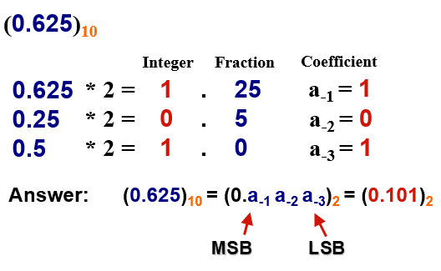
Decimal (Fraction) to Binary Conversion
Multiply the number by the ‘Base’ (=2)
Take the integer (either 0 or 1) as a coefficient
Take the resultant fraction and repeat the division
Example:

Slide 21
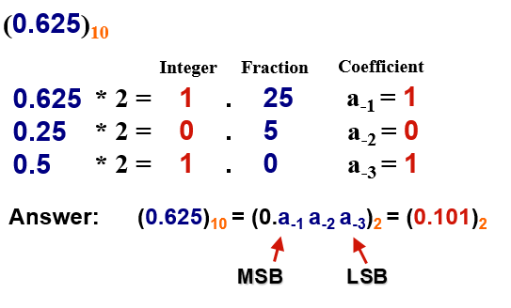
Decimal (Fraction) to Binary Conversion
Multiply the number by the ‘Base’ (=2)
Take the integer (either 0 or 1) as a coefficient
Take the resultant fraction and repeat the division
Example:

Slide 22
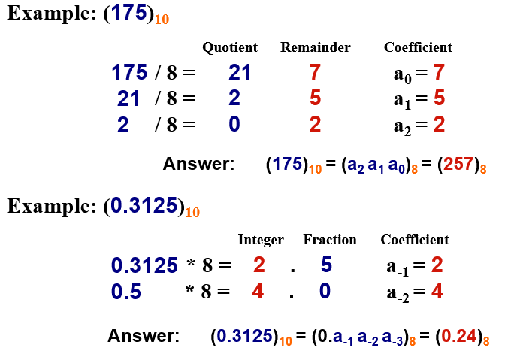
Decimal to Octal Conversion

Slide 23
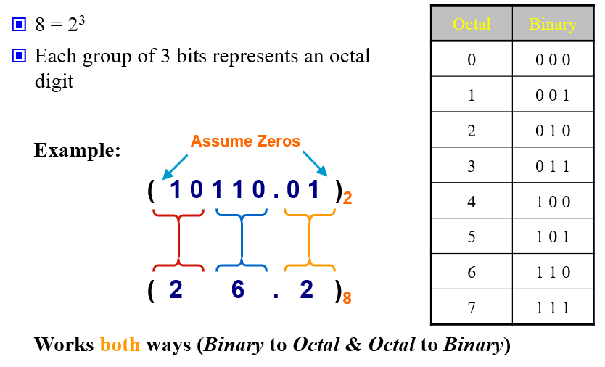
Binary− Octal Conversion

Slide 24
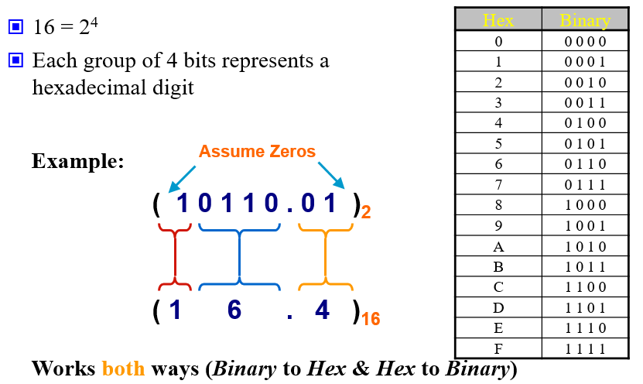
Binary−Hexadecimal Conversion
Prof. Dr. Muhammad Shahin Uddin
Email: muhammad.uddin@northsouth.edu
Out
Ashraful.sarker@nort

Slide 25
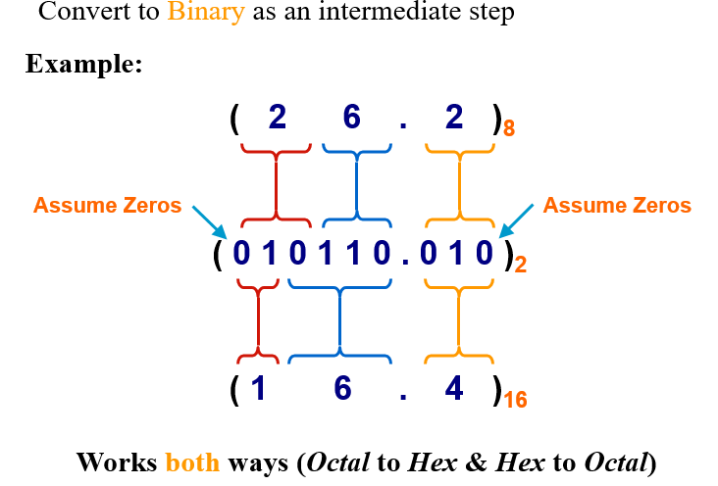
Octal−Hexadecimal Conversion

Slide 26
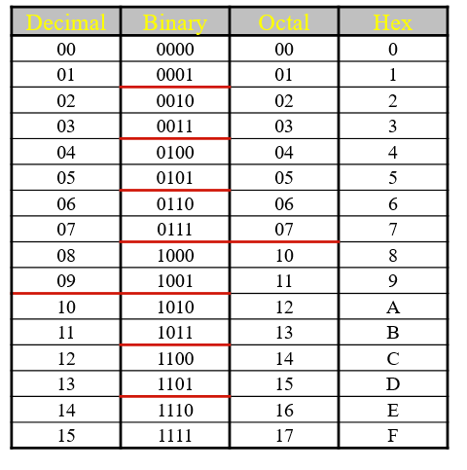
Decimal, Binary, Octal and Hexadecimal

Slide 27
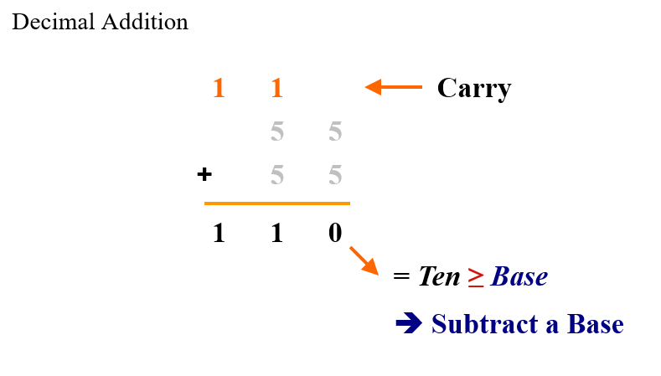
Addition

Slide 28
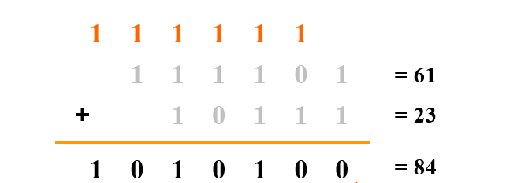
Binary Addition

Slide 29
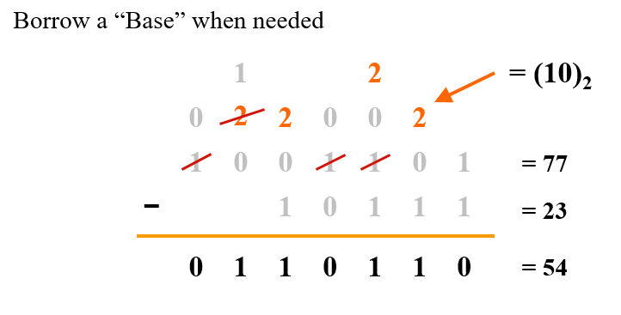
Binary Subtraction

Slide 30
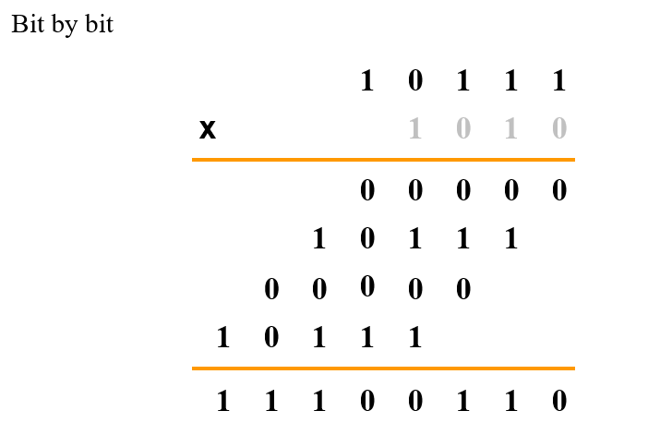
Binary Multiplication

Slide 31
Base Conversion
Examples:
(11010)₂ =( ? )₁₀
N = 1´2⁴ + 1´2³ + 0´2² + 1´2¹ + 0´2⁰
= (16)₁₀ + (8)₁₀ + 0 + (2)₁₀ + 0
= (26)₁₀
(627)₈ = ( ? )₁₀
N = 6´8² + 2´8¹ + 7´8⁰
= (384)₁₀ + (16)₁₀ + (7)₁₀
= (407)₁₀

Slide 32
Base Conversion
(11010)₂ →( ? )₁₀
N = 1×2⁴ + 1×2³ + 0×2² + 1×2¹ + 0×2⁰
= (16)₁₀ + (8)₁₀ + 0 + (2)₁₀ + 0
= (26)₁₀
(627)₈ → ( ? )₁₀
N = 6×8² + 2×8¹ + 7×8⁰
= (384)₁₀ + (16)₁₀ + (7)₁₀
= (407)₁₀

Slide 33
Examples of Base Conversion (3)
(315)₁₀ = (473)₈
(315)₁₀ = (13B)₁₆

Slide 34
Base Conversion (5)
(0.479)₁₀ = (0.3651…)₈
MSD 3.832 ← 0.479 × 8
6.656 ← 0.832 × 8
5.248 ← 0.656 × 8
LSD 1.984 ← 0.248 × 8
…
(0.479)₁₀ = (0.0111…)₂
MSD 0.9580 ← 0.479 × 2
1.9160 ← 0.9580 × 2
1.8320 ← 0.9160 × 2
LSD 1.6640 ← 0.8320 × 2
…

Slide 35
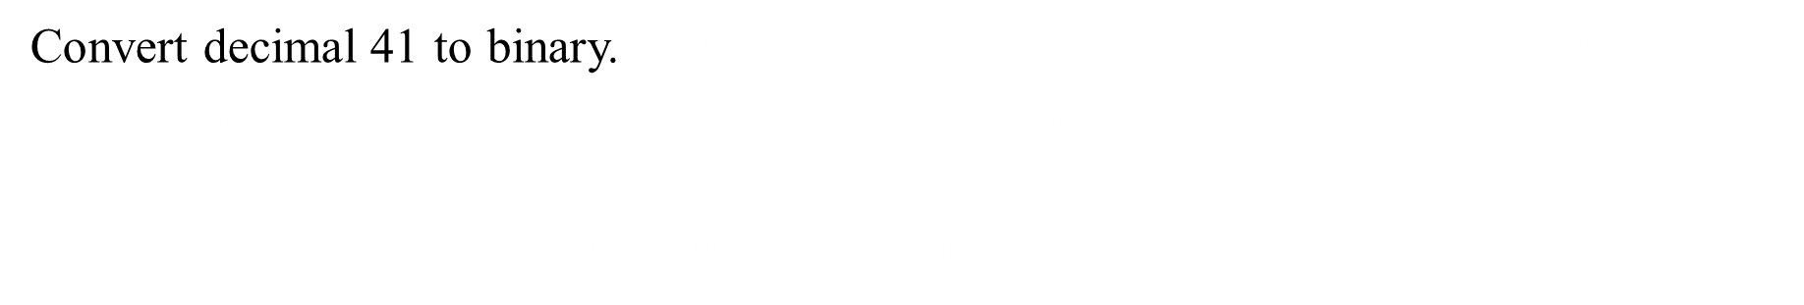
Example 1
Convert decimal 41 to binary. First, 41 is divided by 2 to give an integer quotient of 20 and a remainder of $\frac{1}{2}$. Then the quotient is again divided by 2 to give a new quotient and remainder. The process is continued until the integer quotient becomes 0. The coefficients of the desired binary number are obtained from the remainders as follows:

Slide 36
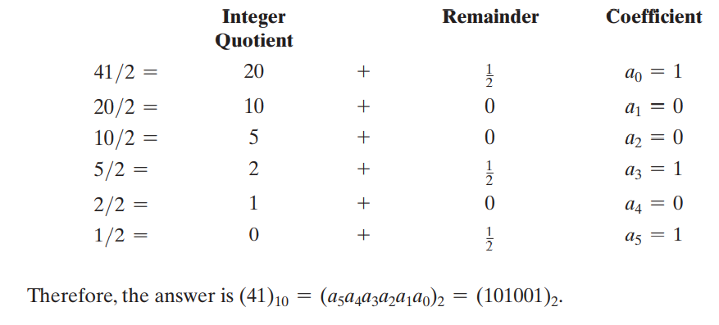

Example 1
Convert decimal 41 to binary. First, 41 is divided by 2 to give an integer quotient of 20 and a remainder of $\frac{1}{2}$. Then the quotient is again divided by 2 to give a new quotient and remainder. The process is continued until the integer quotient becomes 0. The coefficients of the desired binary number are obtained from the remainders as follows:

Slide 37
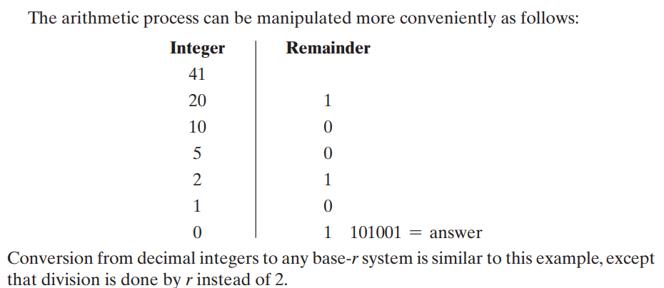
Example 1
Convert decimal 41 to binary. First, 41 is divided by 2 to give an integer quotient of 20 and a remainder of $\frac{1}{2}$. Then the quotient is again divided by 2 to give a new quotient and remainder. The process is continued until the integer quotient becomes 0. The coefficients of the desired binary number are obtained from the remainders as follows:

Slide 38
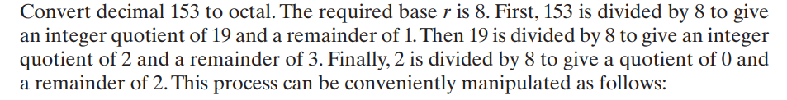
Example 2

Slide 39
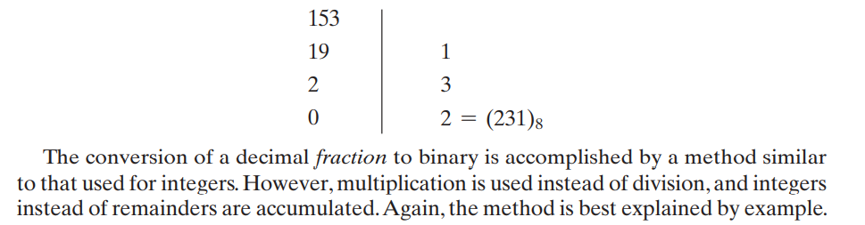
Example 2

Slide 40
Complements
r’s complements
(r-1)’s complements
 | r’s | (r-1)’s
r=10 | 10’s com | 9’s
r=2 | 2’s com | 1’s
r=8 | 8’s com | 7’s
r=16 | 16’s com | 15’s

Slide 41
Complements
Complement number system:
An alternative representation of numbers in a fixed-radix number system.
Why complement of a number is used?
Simplify the subtraction operation
Logical manipulations.
For each radix-r system (radix r represents base of number system) there are two types of complements.

Slide 42
Binary Subtraction using 1’s complement
Step 1: Convert number to be subtracted to it’s 1’s complement.
Step 2: Perform addition
If the final carry is 1 then add it to the results obtained in step 2 is negative in step 2
Example: Perform (1100)₂ –(0101)₂
A=1100 and B=0101
1’s complement of B =1010=-B
1 1 0 0
1 0 1 0
101 1 0
1
₀ ₁ ₁ ₁

Slide 43
Complements
There are two types of complements for each base-r system: the radix complement and diminished radix complement.
Diminished Radix Complement - (r-1)’s Complement
Given a number N in base r having n digits, the (r–1)’s complement of N is defined as:
(r^{n} –1) – N
Example for 6-digit decimal numbers:
9’s complement is (r^{n} – 1)–N = (10⁶–1)–N = 999999–N
9’s complement of 546700 is 999999–546700 = 453299
Example for 7-digit binary numbers:
1’s complement is (r^{n} – 1) – N = (2⁷–1)–N = 1111111–N
1’s complement of 1011000 is 1111111–1011000 = 0100111
Observation:
Subtraction from (r^{n} – 1) will never require a borrow
Diminished radix complement can be computed digit-by-digit
For binary: 1 – 0 = 1 and 1 – 1 = 0

Slide 44
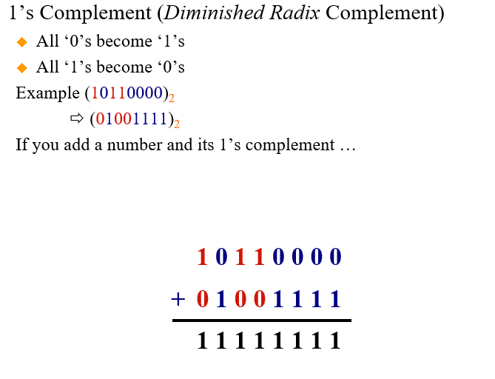
Complements

Slide 45
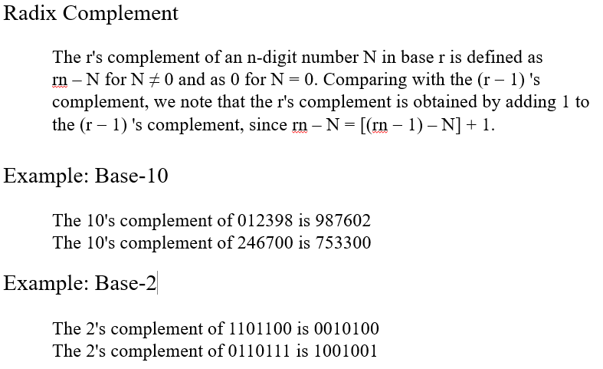
Complements
Radix Complement:
The r’s complement of an n digit number in base r is defined as (r^{n}-N) for N≠0 and as 0 for N=0. Comparing the (r-1)’s complement, we note that the r’s complement is obtained by adding 1 to the (r-1)’s complement, since (r^{n}-N)=[(r^{n}-1)-N]+1.

Slide 46
Complements
Radix Complement:
The r’s complement of an n digit number in base r is defined as (r^{n}-N) for N≠0 and as 0 for N=0. Comparing the (r-1)’s complement, we note that the r’s complement is obtained by adding 1 to the (r-1)’s complement, since (r^{n}-N)=[(r^{n}-1)-N]+1.
1000000-1=9999999
999999-012398=987601+1
1 1 1 1 1 1 1
- 1 1 0 1 1 0 0
= ------------------------
0 0 1 0 1 0 0
+ 1
0 0 1 0 1 0 0

Slide 47
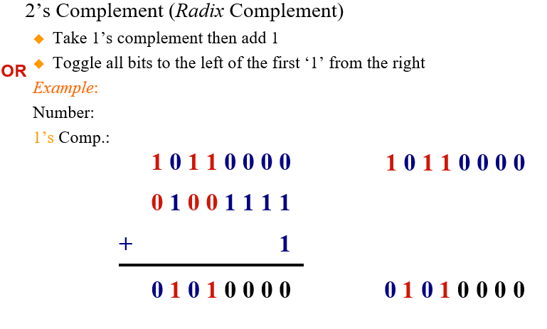
Complements

Slide 48
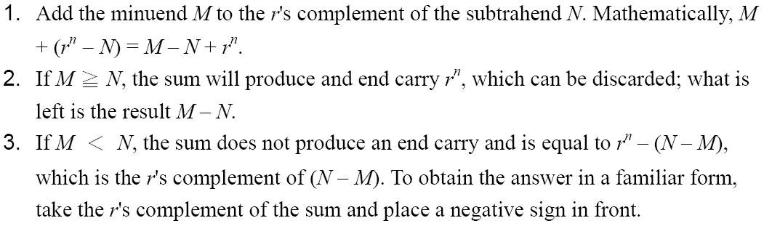
Complements
Subtraction with Complements
The subtraction of two n-digit unsigned numbers M – N in base r can be done as follows:

Slide 49
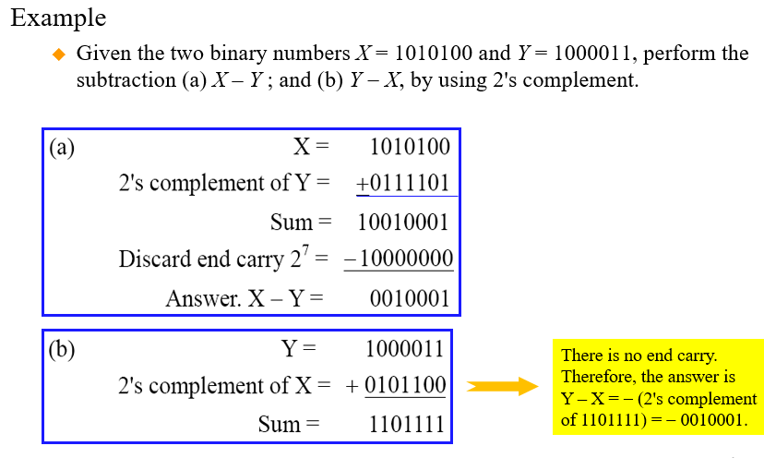
Complements

Slide 50
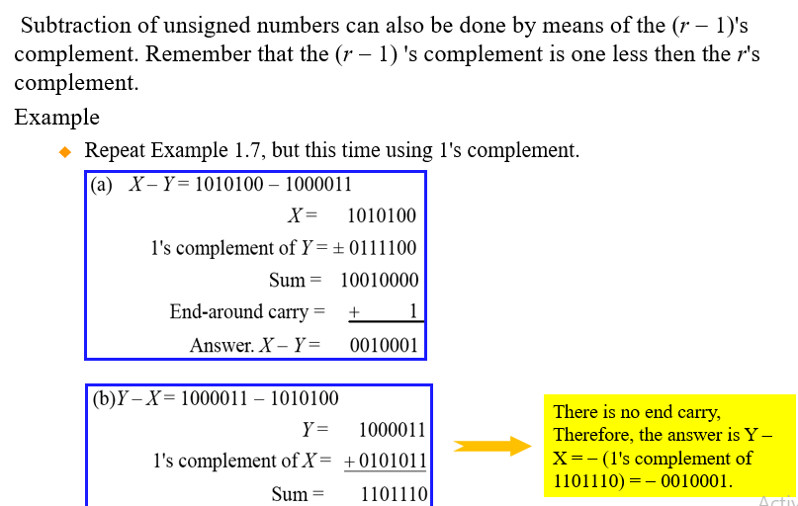
Complements

Slide 51
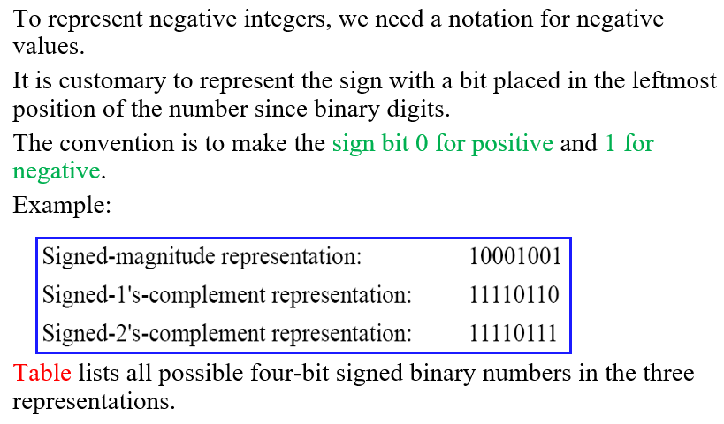
Signed Binary Numbers

Slide 52
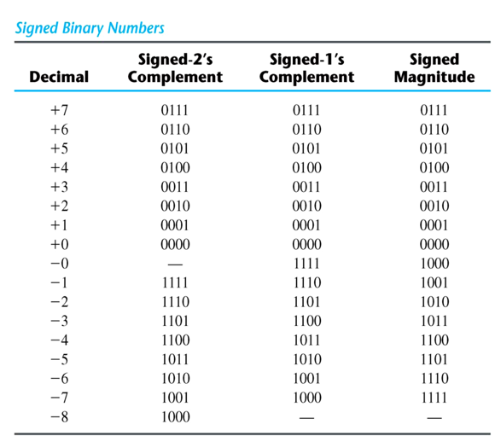
Signed Binary Numbers

Slide 53
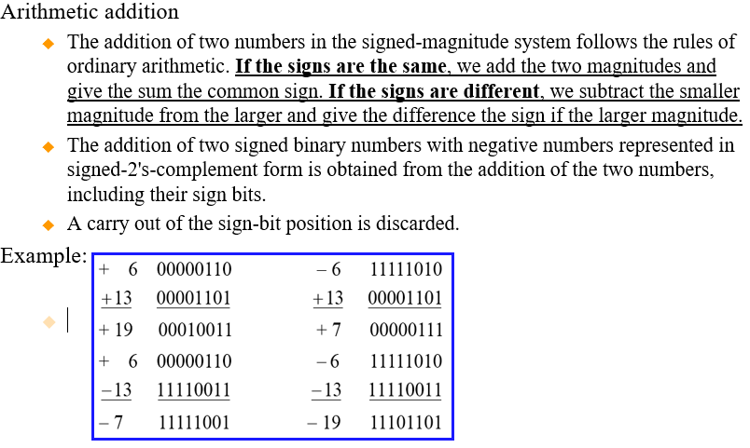
Signed Binary Numbers

Slide 54
Booth’s Algorithm for 2’s Complement Multiplication
Can Multiply
Two positive numbers
Two negative numbers
One positive and one negative number
Important part of ALU design
Use adder circuit only
No required multiplier circuit

Slide 55
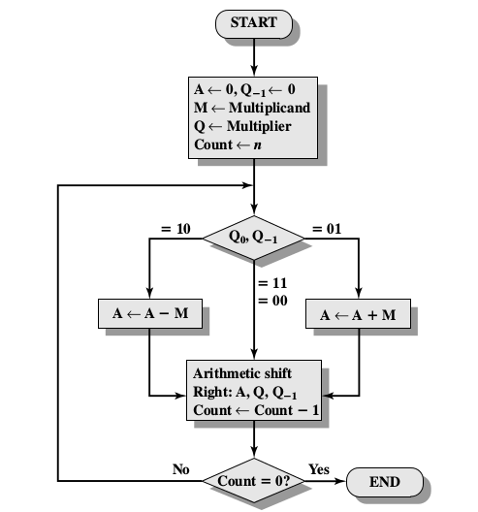
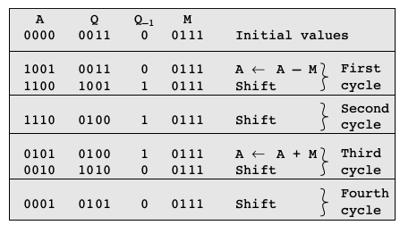
Booth’s Algorithm for 2’s Complement Multiplication

Slide 56
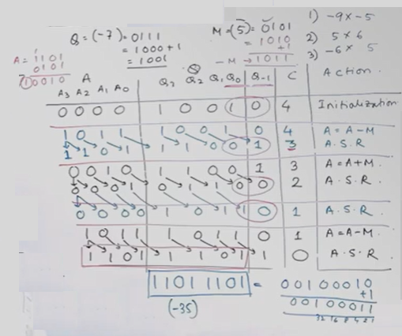
Booth’s Multiplication

Slide 57
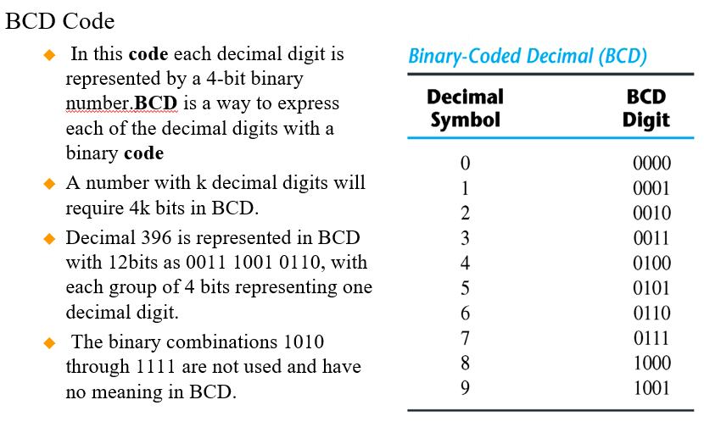
Binary Codes

Slide 58
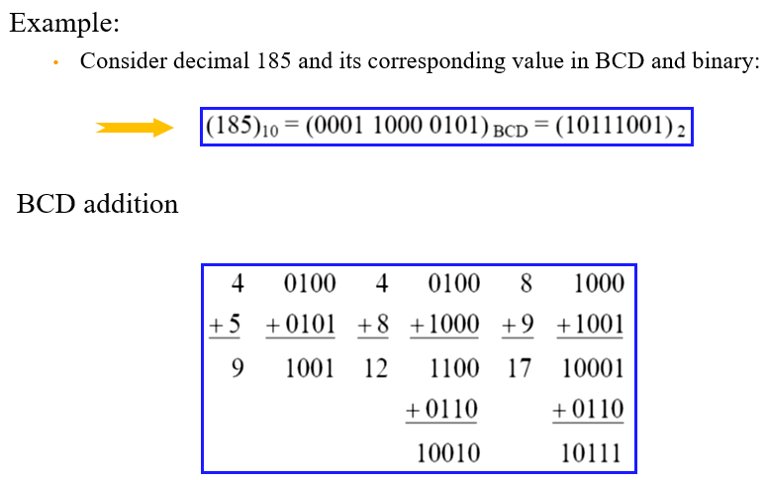
Binary Code

Slide 59
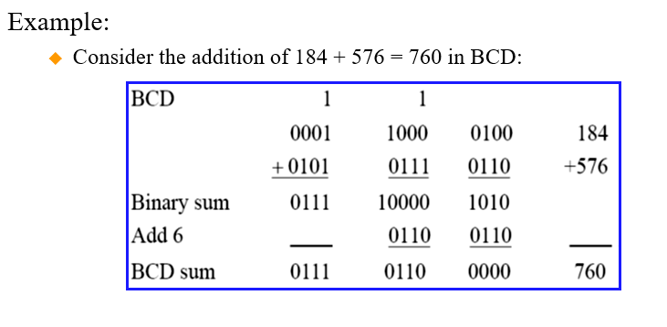
Binary Code

Slide 60
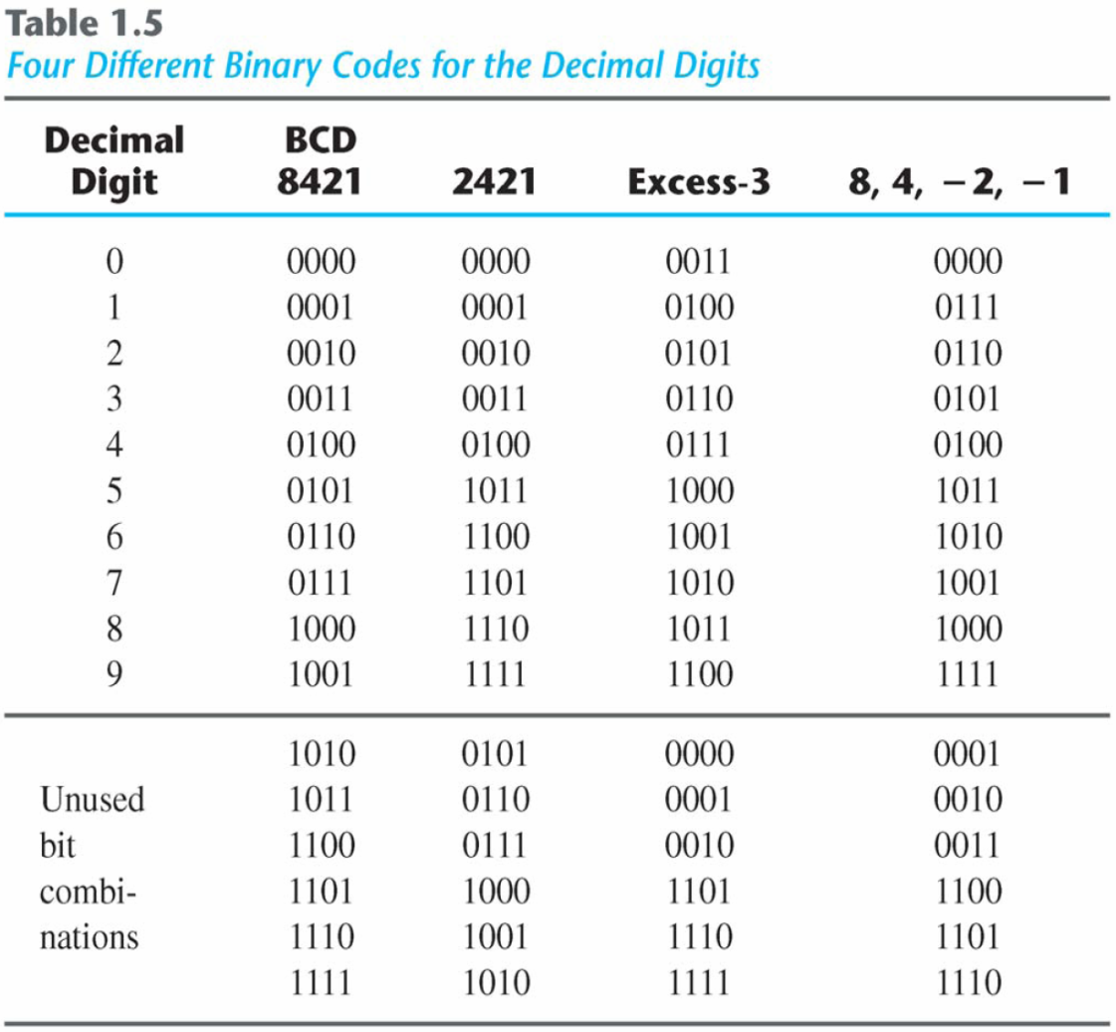
Binary Codes
Other Decimal Codes – weighted representation of decimal numbers in binary.

Slide 61
Gray Code
Definition: Gray Code is the minimum-change code category of coding in which, the two consecutive values changes by only a single bit. More specifically we can say, it is a binary number system where while moving from one step to the next, only a single bit shows variation.
The advantage is that only bit in the code group changes in going from one number to the next.
Error detection.
Representation of analog data.
Low power design

Slide 62
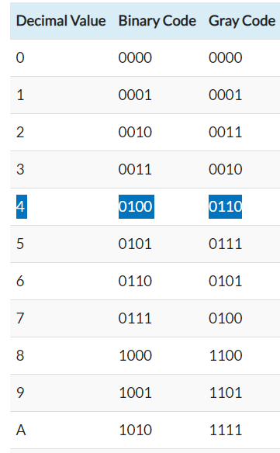
Gray Code
The conversion process from binary code to a gray involves the following steps:
Firstly, record the most significant bit or MSB or the leftmost bit of the given binary data as it is, to have MSB of gray equivalent.
Now, proceed towards adding the adjacent bits of the binary data starting from MSB with its adjacent bit to LSB. While adding, put the summation obtained in place of next bit and ignoring the carry.
Repeat the same process for all the bits in the sequence till LSB.
This is how the binary code is converted into gray equivalent.
Binary to Gray Code Conversion

Slide 63
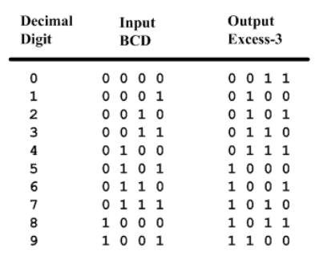
BCD-to-Excess-3 Code converter
BCD is a code for the decimal digits 0-9
Excess-3 is also a code for the decimal digits

Slide 64
Specification of BCD-to-Excess3
Inputs: a BCD input, A,B,C,D with A as the most significant bit and D as the least significant bit.
Outputs: an Excess-3 output W,X,Y,Z that corresponds to the BCD input.
Internal operation – circuit to do the conversion in combinational logic.
Formulation of BCD-to-Excess-3
Excess-3 code is easily formed by adding a binary 3 to the binary or BCD for the digit.
There are 16 possible inputs for both BCD and Excess-3.
It can be assumed that only valid BCD inputs will appear so the six combinations not used can be treated as don’t cares.

Slide 65
ASCII Code
ASCII is the acronym for the American Standard Code for Information Interchange. It is a code for representing 128 English characters as numbers, with each letter assigned a number from 0 to 127. For example, the ASCII code for uppercase M is 77.
ASCII, a standard data-transmission code that is used by smaller and less-powerful computers to represent both textual data (letters, numbers, and punctuation marks) and noninput-device commands (control characters).

Slide 66
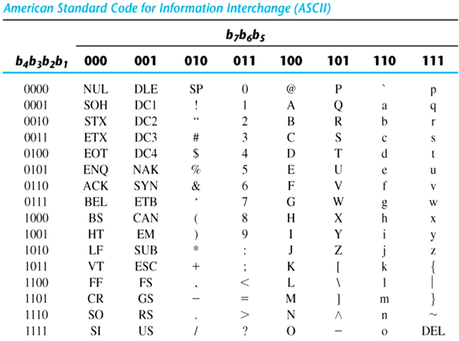
ASCII Code
American Standard Code for Information Interchange (ASCII) Character Code

Slide 67
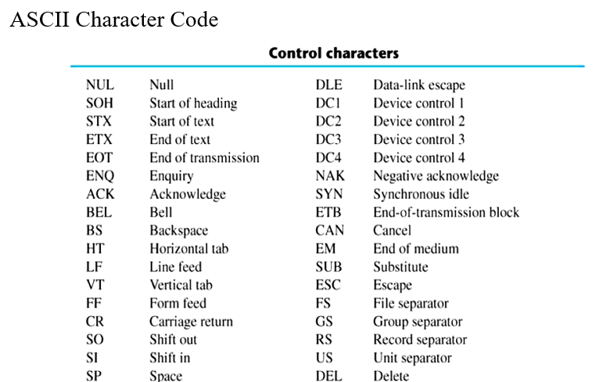
ASCII Code

Slide 68
ASCII Character Codes
American Standard Code for Information Interchange
A popular code used to represent information sent as character-based data.
It uses 7-bits to represent:
94 Graphic printing characters.
34 Non-printing characters.
Some non-printing characters are used for text format (e.g. BS = Backspace, CR = carriage return).
Other non-printing characters are used for record marking and flow control (e.g. STX and ETX start and end text areas).

Slide 69
ASCII Properties
ASCII has some interesting properties:
Digits 0 to 9 span Hexadecimal values 30₁₆ to 39₁₆
Upper case A-Z span 41₁₆ to 5A₁₆
Lower case a-z span 61₁₆ to 7A₁₆
Lower to upper case translation (and vice versa) occurs by flipping bit 6.

Slide 70
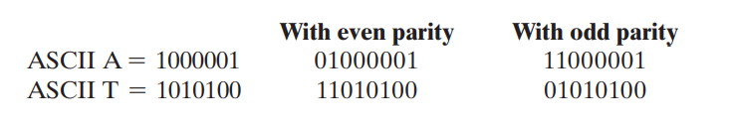
Extended ASCII Code/ Error Detection Code
To detect errors in data communication and processing, an eighth bit is sometimes added to the ASCII character to indicate its parity.
A parity bit is an extra bit included with a message to make the total number of 1’s either even or odd.
Consider the following two characters and their even and odd parity:
The parity bit is helpful in detecting errors during the transmission of information.
Handled by generating an even parity bit at the sending end for each character.
The eight‐bit characters that include parity bits are transmitted to their destination.
The parity of each character is then checked at the receiving end.
If the parity of the received character is not even, then at least one bit has changed value during the transmission.

Slide 71
Binary Codes
In the coding, when numbers, letters or words are represented by a specific group of symbols, it is said that the number, letter or word is being encoded.
The group of symbols is called as a code.
The digital data is represented, stored and transmitted as group of binary bits.
This group is also called as binary code. The binary code is represented by the number as well as alphanumeric letter.

Slide 72
Advantages of Binary Code
Binary codes are suitable for the computer applications.
Binary codes are suitable for the digital communications.
Binary codes make the analysis and designing of digital circuits if we use the binary codes.
Since only 0 & 1 are being used, implementation becomes easy.

Slide 73
Classification of binary codes
The codes are broadly categorized into following four categories.
Weighted Codes
Non-Weighted Codes
Binary Coded Decimal Code
Alphanumeric Codes
Error Detecting Codes
Error Correcting Codes

Slide 74
Weighted Codes
Weighted binary codes are those binary codes which obey the positional weight principle. Each position of the number represents a specific weight. Several systems of the codes are used to express the decimal digits 0 through 9. In these codes each decimal digit is represented by a group of four bits.
Non-Weighted Codes
In this type of binary codes, the positional weights are not assigned. The examples of non-weighted codes are Excess-3 code and Gray code. EXCESS-3 CODE The Excess-3 code is also called as XS-3 code. It is non-weighted code used to express decimal numbers. The Excess-3 code words are derived from the 8421 BCD code words adding (0011)2 or (3)10 to each code word in 8421. The excess-3 codes are obtained as follows

Slide 75
THANKS

